Slide 1
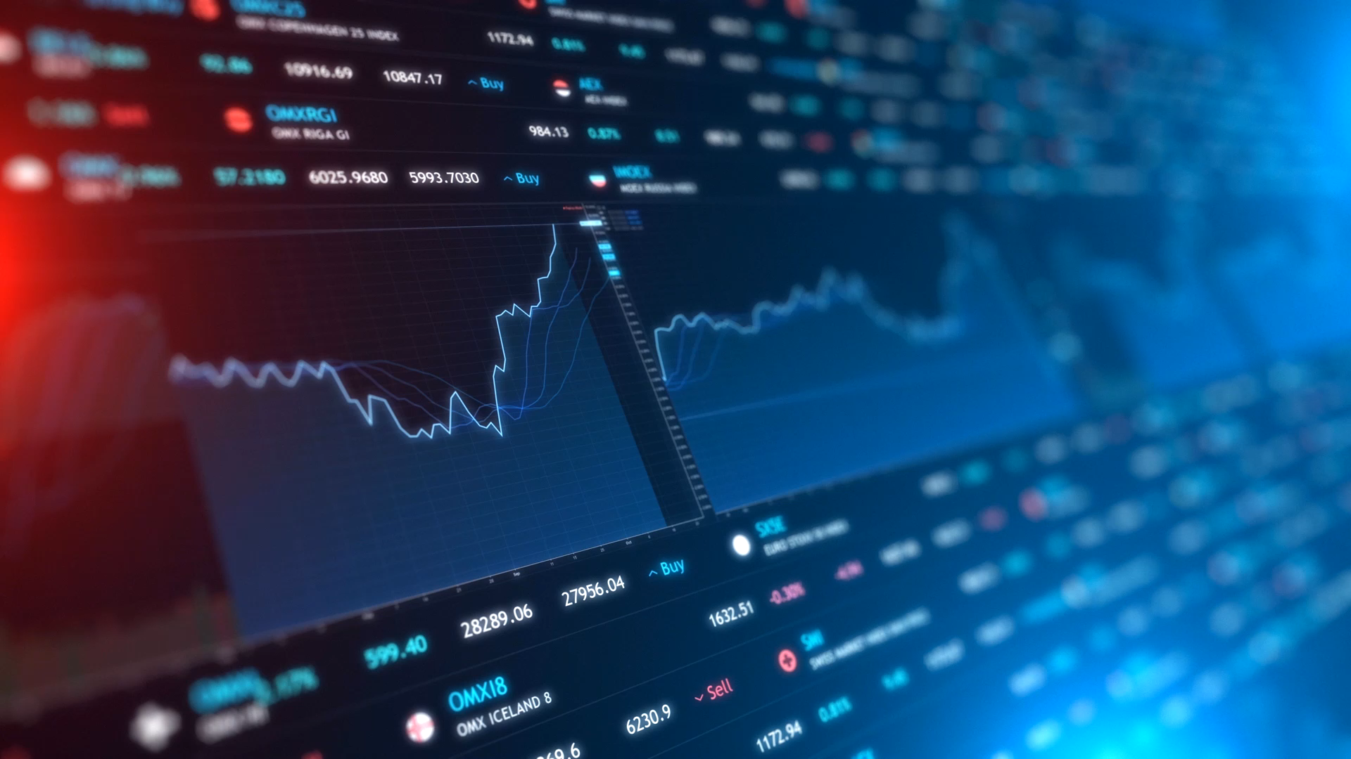
Customer Sentiment Analysis for Apple and Google
Joey Husney
1/28/2021

Slide 2
Business Case
Independent company hired by Apple and Google to predict the sentiment of their tweets
They will use the information we give them to identify which areas are lacking in customer satisfaction
Part of our business case is to give them recommendations on how they can increase customer satisfaction

Slide 3
The data
The data we have been given consists of tweets and manually encoded sentiments relating to each tweet.
The information consists of around 9000 tweets and is from around 2010 (customers talk about 3G iPhone’s)
Out of the 9000 tweets, there are:
5389 that show no emotion
2978 showing positive emotion
570 showing negative emotion
156 that can’t tell – these will be dropped as they have no effect on our model’s predicate abilities.
Must fix class imbalance

Slide 4
Project Approach
Using only Random Forest Classifier because of ability to inspect feature importance.
Testing out same model with different cleaning approaches to see which is best.
Summarize findings at the end with each approach.

Slide 5
Project Outline
Basic data cleaning
Vanilla model without tokenization, lemmatization, or filtering out stop words
Another baseline model, in order to see how model functions without rows that showed no emotions
Tokenization, lemmatization, and filtering stop words.
Final model

Slide 6
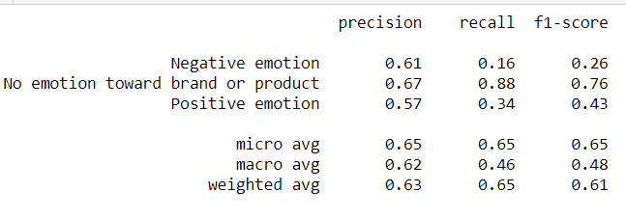
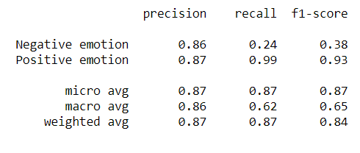
Vanilla Model 1 vs 2
Baseline Model 1:
Although our second model did not include tweets with no emotions, it seems to have done a lot better than the initial model as it went from a 0.43 f1 score to 0.93 for positive emotion and 0.26 to 0.38 for negative emotions
Baseline Model 2:

Slide 7
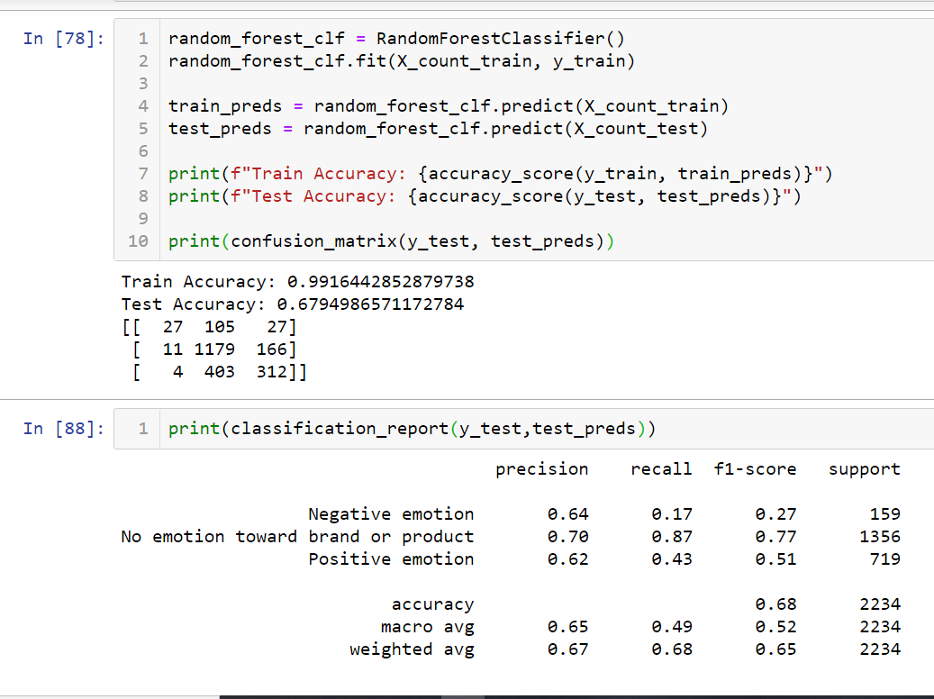
Final model
This model was a Random Forest Model which used a tfidf vectorizer. It seems to have done well regarding the ‘no emotion towards brand or product’ column but not as good for the others.

Slide 8
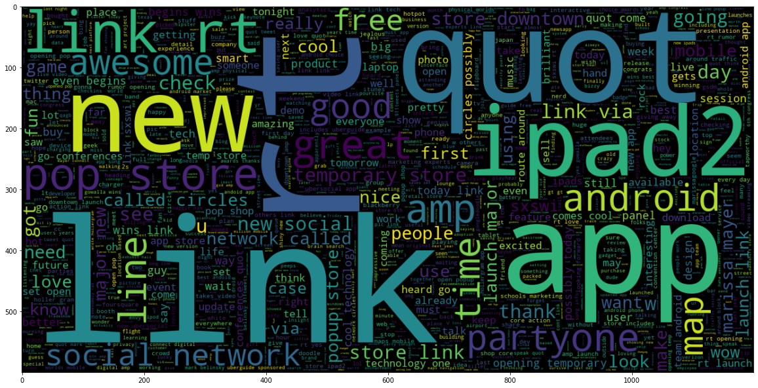
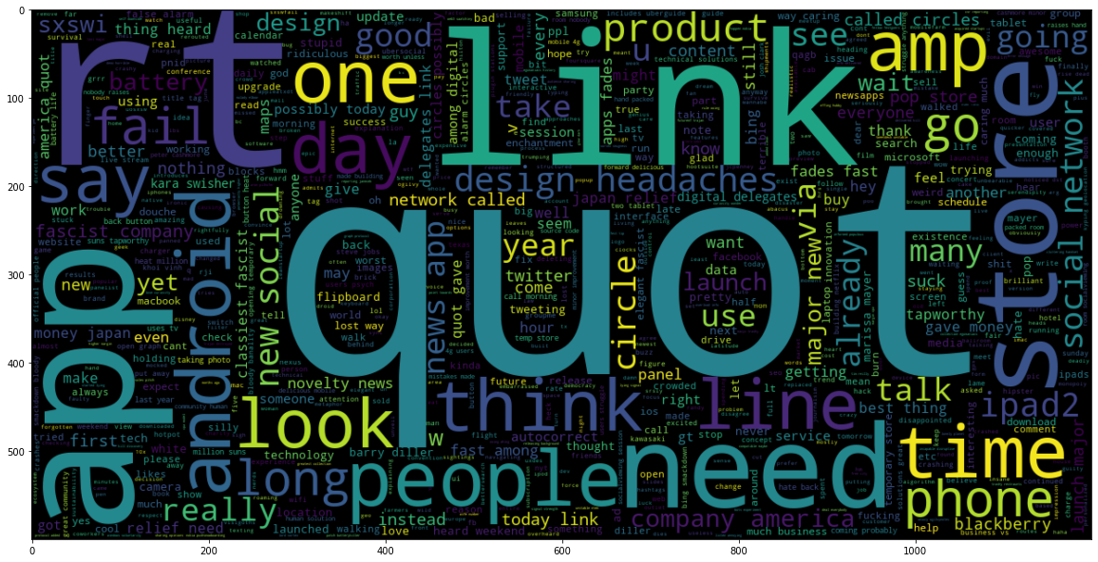
EDA – Word cloud comparison
Positive emotion
Negative emotion

Slide 9

Business recommendations
Fix the lag time on products as many of complaints seem to be about wait time
More advertising to increase popularity (some complains are foolish and not based on anything)
Design should be fixed on some of the product as some customers were complaining about design.

Slide 10

Thank you!
Here is my info for any questions or suggestions:
Github repo: https://github.com/jhusney1/nlp_project_4
Email: joeyhusney1@gmail.com

